Slide 1
Monitoring Analyst
Leonardo dos Santos Skraba

Slide 2
Timeline
Analysis of data at POS
Behavior analysis
Analysis of transactions data
Create the base rules
Create the models
Show the relevance of the features
Create the alerts
Next steps

Slide 3
CHECKOUT 1 AND CHECKOUT 2
ANALYSIS

Slide 4
Understanding the data of checkouts
2 Differents POS
5 checkout variables:
today,yesterday,same day last week, avg last week and avg last month
One day analysis
Hourly information. 00h -> 23h

Slide 5
Methodology
Data Transformation
Data Enrichment: adding behavioral information
Plot bar graph to analyze variables
Plot line graph to analyze behavior

Slide 6
ANALYZING CHECKOUT 1

Slide 7
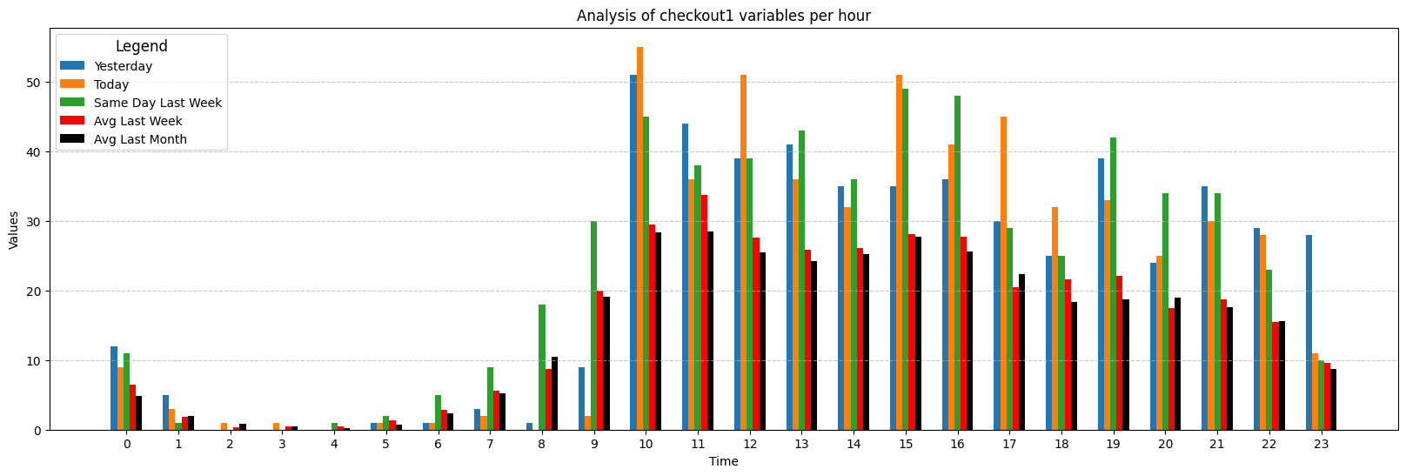
Checkout 1

Slide 8
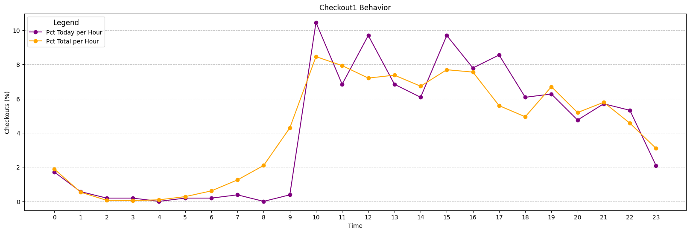
Checkout 1

Slide 9
Conclusion of checkouts 1
Anomalies:
07:00-09:00
11:00-13:00
16:00-17:00

Slide 10
ANALYZING CHECKOUT 2

Slide 11
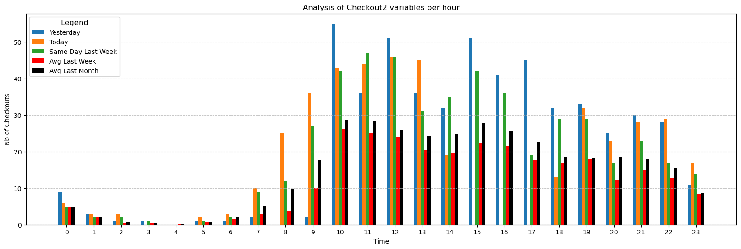
Checkout 2

Slide 12
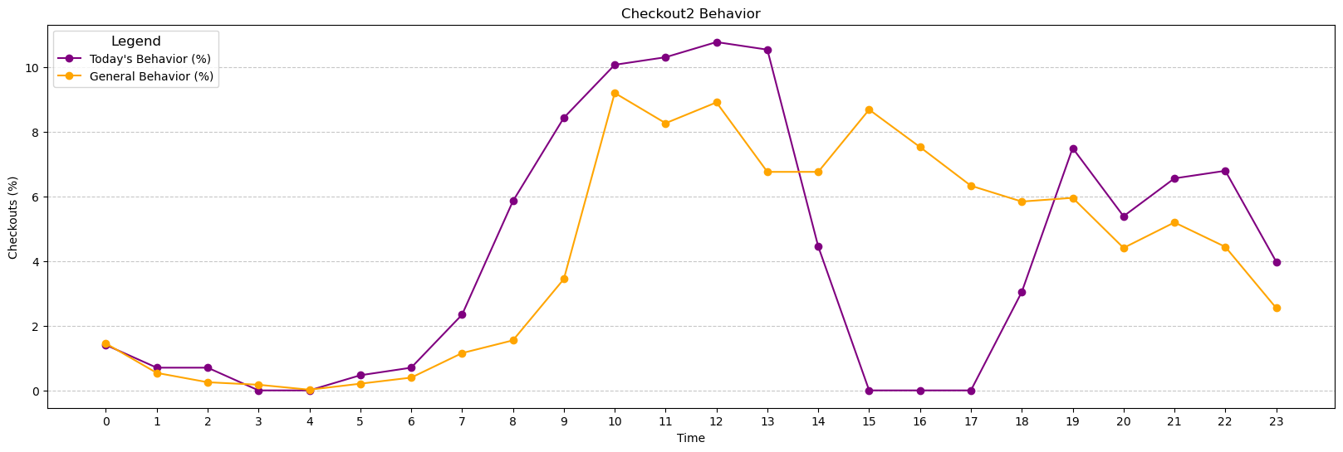
Checkout 2

Slide 13
Conclusion of checkouts 2
Anomalies:
07:00-08:00
10:00-11:00
13:00-19:00

Slide 14
SOLVE THE TRANSACTION PROBLEM

Slide 15
Understanding the data of transactions
2 Differents POS
7 transactions variables:
Approved, failed, denied, reversed, refunded, processing, backend reversed
One day analysis
Data per minute

Slide 16
Objective:
Define which cases get alerted based on predefined rules
Develop predictive models for failed, reversed and denied transactions
Show the most importants variables for the models
Create the alerts

Slide 17
Methodology:
Data Transformation
Plot boxplot for better understanding of data
Create the models
After applying the models and defining the base rules, create alerts based on the defined values

Slide 18
TRANSACTION 1

Slide 19
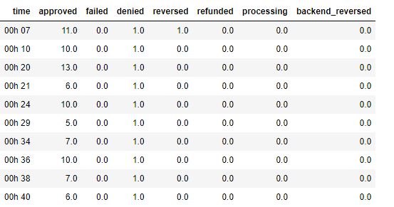
Database Format

Slide 20
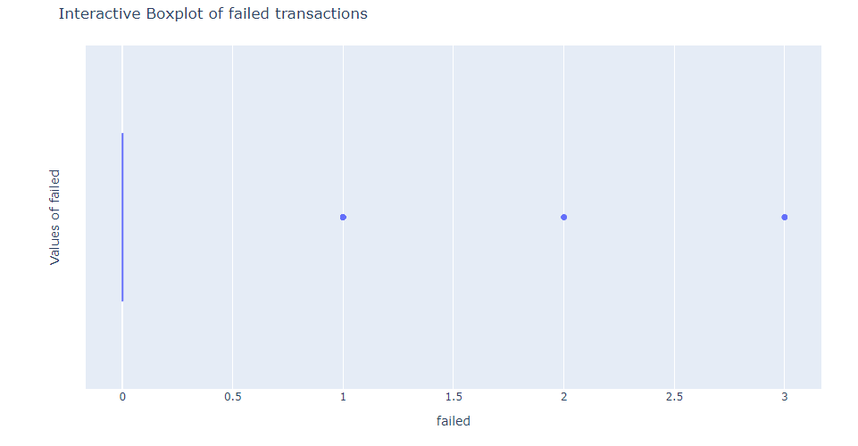
Box Plot (Failed)
Upper Fance: 0

Slide 21
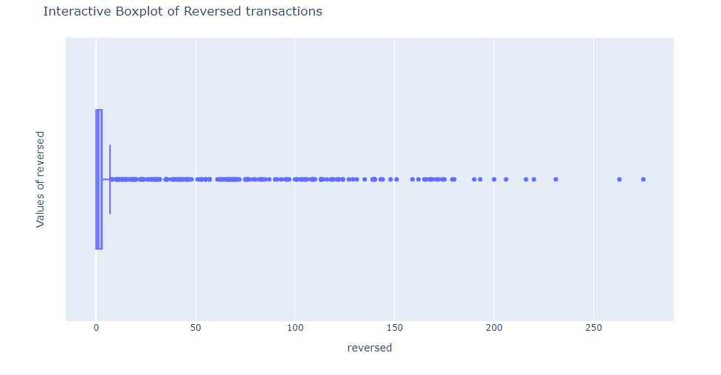
Box Plot (Reversed)
Upper Fance: 7

Slide 22
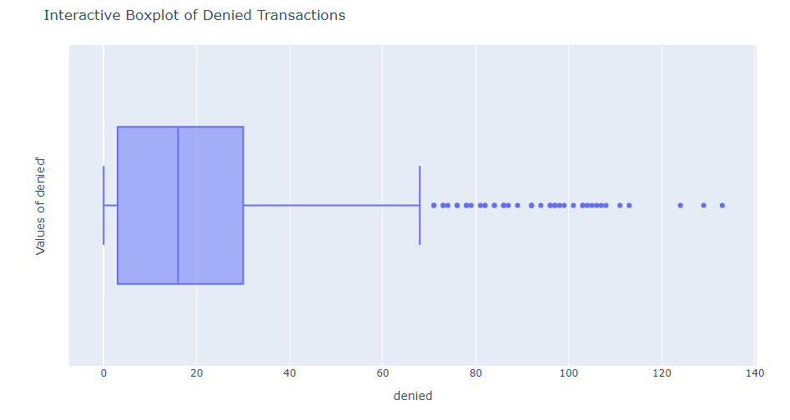
Box Plot (Denied)
Upper Fance: 68

Slide 23
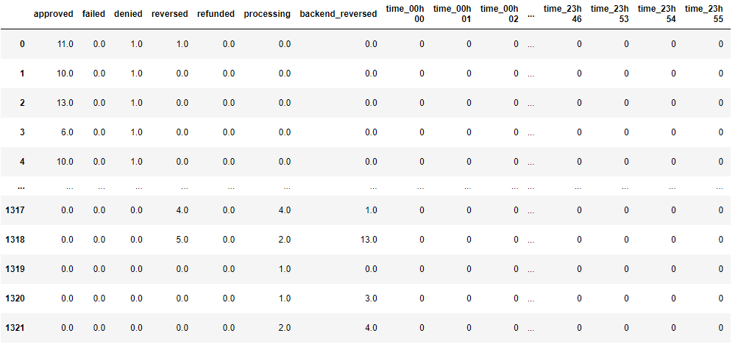
Database Format

Slide 24
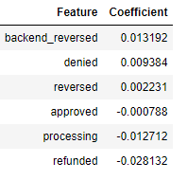
Failed Transaction Model:
In relation to transaction features, these were the relevance

Slide 25
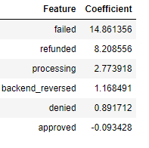
Reversed Transaction Model:
In relation to transaction features, these were the relevance

Slide 26
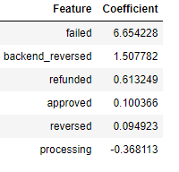
Deneid Transaction Model:
In relation to transaction features, these were the relevance

Slide 27
Alerts:
Failed Alert: alert if there is more transaction than stipulated, in case of ‘failed’ it would be more than 0 per minute
Reversed Alert: alert if there is more transaction than stipulated, in case of ‘reversed’ it would be more than 7 per minute
Deneid Alert : alert if there is more transaction than stipulated, in case of ‘deneid’ it would be more than 68 per minute
0

Slide 28
TRANSACTION 2

Slide 29
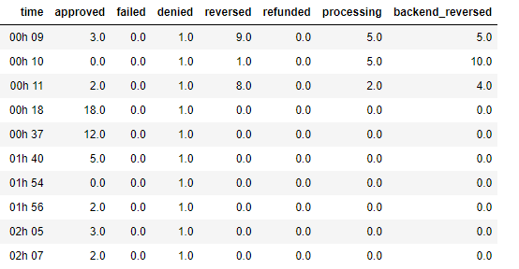
Database Format

Slide 30
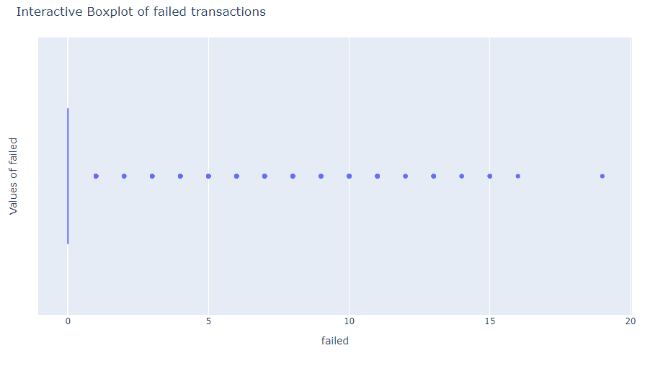
Box Plot (Failed)
Upper Fance: 0

Slide 31
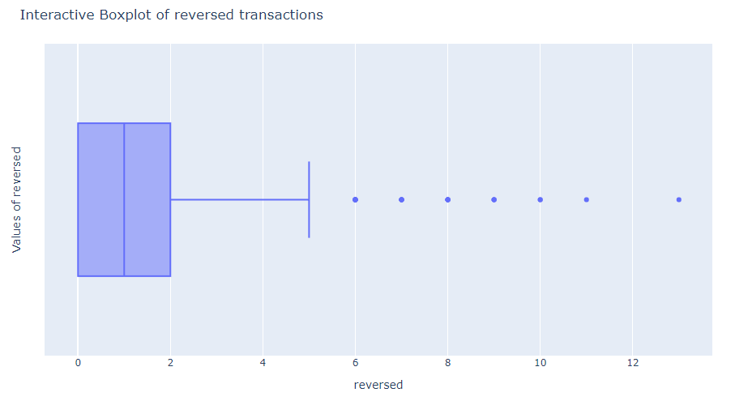
Box Plot (Reversed)
Upper Fance: 5

Slide 32
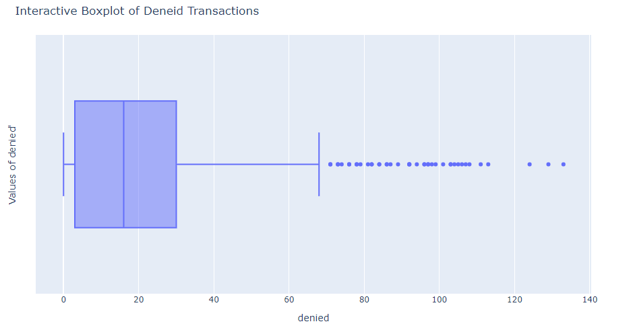
Box Plot (Denied)
Upper Fance: 75

Slide 33
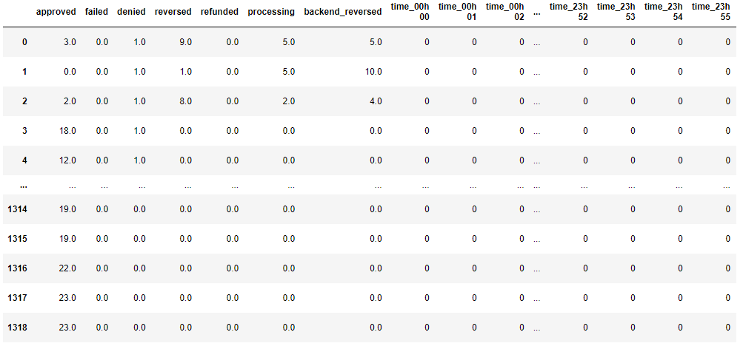
Database Format

Slide 34
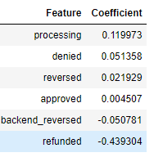
Failed Transaction Model:
In relation to transaction features, these were the relevance

Slide 35
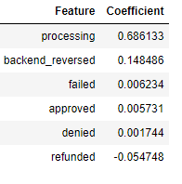
Reversed Transaction Model:
In relation to transaction features, these were the relevance

Slide 36
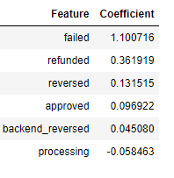
Deneid Transaction Model:
In relation to transaction features, these were the relevance

Slide 37
Alerts:
Failed Alert: alert if there is more transaction than stipulated, in case of ‘failed’ it would be more than 0 per minute
Reversed Alert: alert if there is more transaction than stipulated, in case of ‘reversed’ it would be more than 5 per minute
Deneid Alert : alert if there is more transaction than stipulated, in case of ‘deneid’ it would be more than 75 per minute
0

Slide 38
NEXT STEPS

Slide 39
What are the next steps ?
Track forecasts and alerts to optimize the models
Follow the next few days to improve the rule based
0

